Slide 1
CRFC Evaluation Results
Fiorella A. Heald, Sherry L. Grace, Abraham S. Babu
On behalf of Subject Matters Experts

Slide 2
Overview
CRFC started in 2017
Goal to:
Take stock of reach
Get feedback on quality and impact;
Publish for broader marketing and show evidence
Also get input on how to improve
Survey of CRFC non-completing applicants and completers
Survey of USV learners (Indian cardiologists) too (1 module / month format)
Not shown, but shared with USV

Slide 3
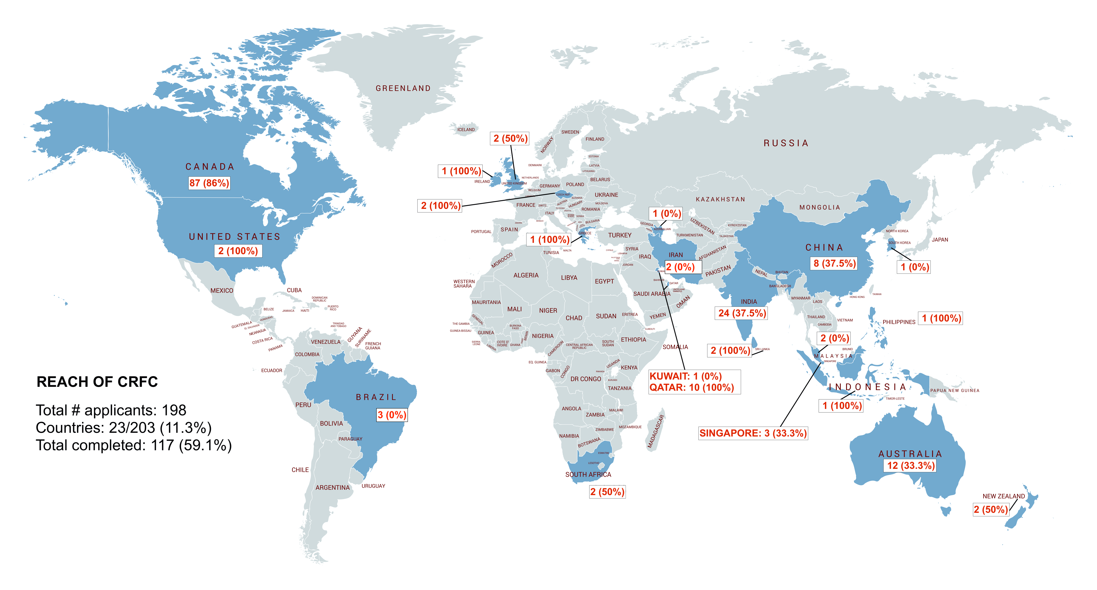
Notes:
As of August 7, 2020

Slide 4
CRFC Completers N=37/108 (34.3%)

Slide 5
Country of Residence
Sex
67.6%
32.4%

Slide 7
Feedback on CRFC Program - Overall

Slide 8
Evaluation of Each Module
Mean ± standard deviation

Slide 9
Question | N | Mean ± SD
How satisfied were you with the CRFC learning experience overall?ǂ | 37 | 4.49 ± 0.51
Please rate the quality of information in each CRFC module: [The CRFC overall]¤ | 36 | 4.50 ± 0.56
Please rate how useful each module was to your practice: [The CRFC overall]† | 37 | 4.35 ± 0.79
The modules achieved their stated learning objectives.§ | 37 | 4.49 ± 0.51
I was engaged by the quality of the presentations.§ | 36 | 3.94 ± 0.86
The website was easy to access and use.§ | 37 | 4.24 ± 0.83
The CRFC met my learning needs and goals.§ | 37 | 4.32 ± 0.85
The information presented was relevant to my geographic context.§ | 37 | 4.24 ± 0.83
The course fee was acceptable.§ | 37 | 4.32 ± 0.85
The level of the material was too difficult.§* | 37 | 2.16 ± 1.26
The text in the PowerPoint slides was clear to read.§ | 37 | 4.00 ± 1.11
The videos for each module were easy to hear and follow.§ | 37 | 3.73 ± 0.96
ǂLikert scale: 1=Very dissatisfied; 2=Somewhat dissatisfied; 3=Neutral; 4=Quite satisfied; 5=Very satisfied
¤Likert scale: 1=Poor; 2=Not good; 3=Neutral; 4=Good; 5=Excellent
†Likert scale: 1=Not at all useful; 2=Somewhat useful; 3=Neither useful nor not useful; 4=Quite useful; 5=Very useful
§Likert scale: 1=Strongly disagree; 2=Disagree; 3=Neutral; 4=Agree; 5=Strongly agree
*Low score means positive response as reverse-scored
N=sample size; SD=standard deviation

Slide 10
Was the Course Fee Acceptable?

Slide 11
About the Exam

Slide 12
Positive Impact
Learners rated 4.30 ± 0.66 (out of 5) that they would recommend CRFC to others.
Learners rated 4.38 ± 0.89 (out of 5) that the information provided will contribute to their work and/or the care of their patients.
29 (78.4%) have used the information from the modules in their practice.

Slide 13
As a result of taking this online course, my patients, practice, research or health region will benefit because:
“I will openly share this information with my friends and colleagues to promote the benefits of CR to increase the referral rate of CR in health care settings.”
“I will be more attentive to the condition of people and try to identify possible CVD risk factors present to help find a solution before an event arises.”
“I have better understanding of the patients’ full needs base and not just how exercise is good for them. It will allow me to bring more suggestions to the cardiac team as to how they should manage post-discharge.”
“I will engage patients with more confidence.”
“I will inspire and guide them to be more active, learn how to monitor their progress and their tolerance so pain becomes a guide--not a hindrance. I will know how to teach them to self-monitor, to eat more healthily and to understand health risks.”

Slide 14
What was the most significant thing you learned/took away from the CRFC modules?
“Learning is indeed a continues process! And hats off to those who have a golden heart that are genuinely exerting effort to share the knowledge. You are all very inspirational. You not only increased our knowledge but also our motivation to deliver competent and quality service to our cardiac rehab patients.“
“How each interdisciplinary approach collaboratively apply to cardiovascular health.“
“You need to have a knowledge on all aspects that pertains to cardiac rehabilitation and not being confined to only a particular aspect.“
“That cardiac rehabilitation can be cost-effective and that every healthcare worker can help prevent cardiovascular disease by means of patient education.“
“The thing that I was most surprised about was the fact that screening assessments for mental health were not mandatory for CR. However, the reasoning behind it makes sense.“
“More confidence in dealing with higher risk patients with regard to exercise programming.“
“Cardiac rehab is very important, but often not done properly.“
“Significant new knowledge gained.”

Slide 15
Open-ended Comments on Course: for Improvement
The website would be non-responsive at points when going to different slides or modules.
I did prefer presentation of modules that had video of the speaker and the slides on to see where they were at to follow along.
Technical issues with tests, slides, videos (fixed)
low volume; Some modules were hard to hear because the audio was not that great (fixed)
Excellent work; modules could be updated after some time (in progress)

Slide 16
Non-Completers N=16/73 (21.9%)

Slide 17
Country of Residence

Slide 18
Sex
Work Status
68.8%
31.3%

Slide 19
Reasons why they did not complete CRFC | N | Mean ± SD
I didn’t have time. | 16 | 3.06 ± 1.18
The course fee was too high. | 15 | 3.00 ± 1.07
I started the modules, but they were too easy for me based on the experience and knowledge I already have. | 12 | 3.00 ± 0.95
I had technical challenges with the website. | 15 | 2.60 ± 1.12
I didn’t have the requirements to be eligible to take the course. | 12 | 2.42 ± 1.44
I had trouble paying the course fee via paypal. | 13 | 2.38 ± 1.45
I didn’t have the information needed to submit with my application. | 14 | 2.36 ± 1.08
I started the modules, but they were too hard for me. | 13 | 2.08 ± 0.95
I started the modules, but they were not relevant or of interest to me. | 13 | 1.92 ± 0.76
Likert scale: 1=Strongly disagree; 2=Disagree; 3=Neutral; 4=Agree; 5=Strongly agree

Slide 20
Barriers to Taking CRFC Course (open-ended)
Busy with work/study/life (not enough time)
COVID-19
Did not have CPR certification (incorrect assumption clarified)
Technical difficulties (slides not loading)
Personal problems
Cost

Slide 21
What could we do to the course so it would better meet your needs? (open-ended)
“Provide reading materials” (we now do)
“It would be nice to have exam at the end of each module to begin with next section”
“Make it available for free in Iran”

Slide 22
Last bits… | N | Mean ± SD
It was very clear how to apply and get started with the CRFC. | 16 | 3.38 ± 1.41
If I had any problems, the CRFC admin person was quickly able to help me. | 14 | 3.50 ± 1.16
To what degree would you recommend the CRFC to others? | 16 | 4.13 ± 0.81
Likert scale: 1=Strongly disagree; 2=Disagree; 3=Neutral; 4=Agree; 5=Strongly agree
N=sample size; SD=standard deviation

Slide 23
Q & A

